Slide 1


Slide 2
Buddy App
I believe that CS is the ultimate avenue for addressing deep-rooted issues in the education system that requires a structural overhaul in terms of technological design and pedagogical delivery. In 2018, I developed Buddy, an iOS and Android based app that facilitates parent-teacher interaction, personalized feedback, and peer learning.
I programmed buddy in ReactJS, Python and C++, and programmed features like an in-built chat room, a self-service portal and a notification system that enables parents to receive alerts for time-sensitive news and information.
I wanted Buddy to collapse barriers of communication to make education more democratic and dialogical; in short, I like thinking about simple CS utilities that hack the complex stratified problems of a society in transition.
The goal of this app is to aid school to connects parent, child and teacher. Provide parents and students with the news, daily notes TIME TABLE and option for them to send messages. It also facilitates teachers for taking attendance and providing notes to the students on daily basis.

Slide 3
Roles in System
There are 3 roles in the system.
Teacher (uses the system via mobile app)
Parents / Students (uses the system via mobile app)
Admin (uses the system via admin panel)

Slide 4
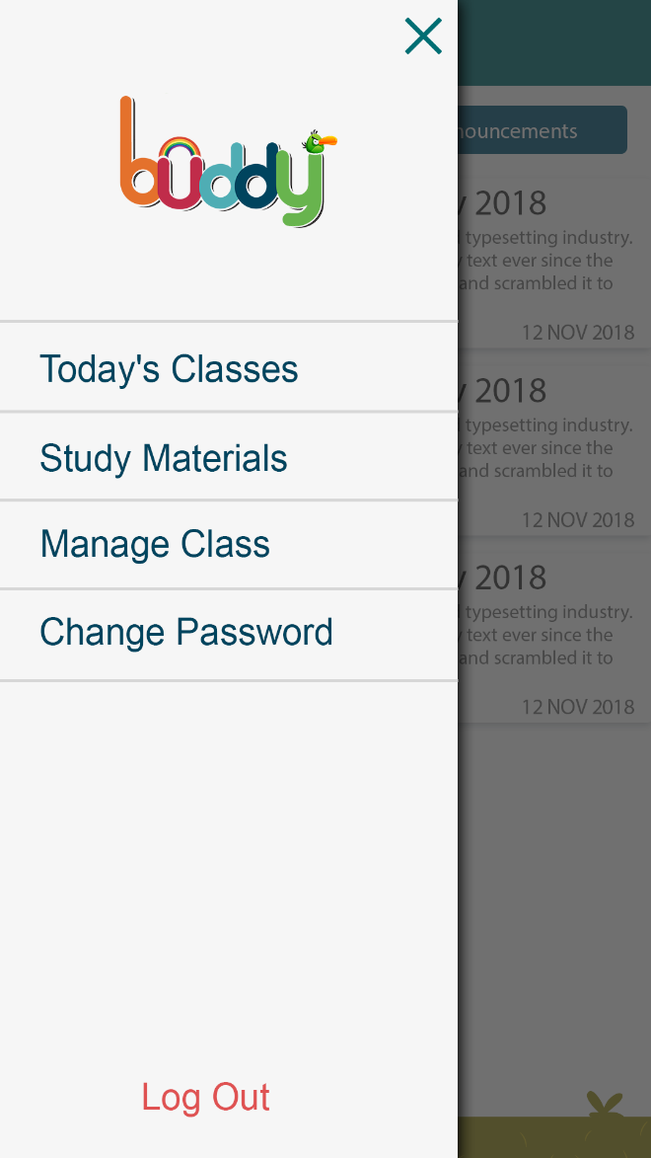
Teacher’s Functionality
View today’s classes
Manage Class(if teacher is class teacher)
Manage Attendance
Manage Class Notes
Manage Study Materials
Manage Profile

Slide 5
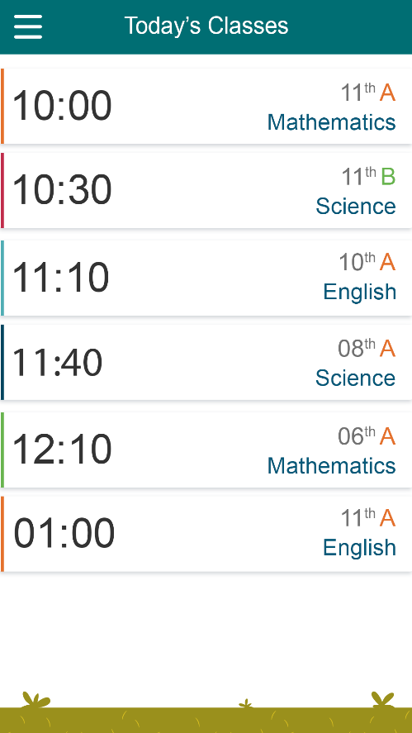
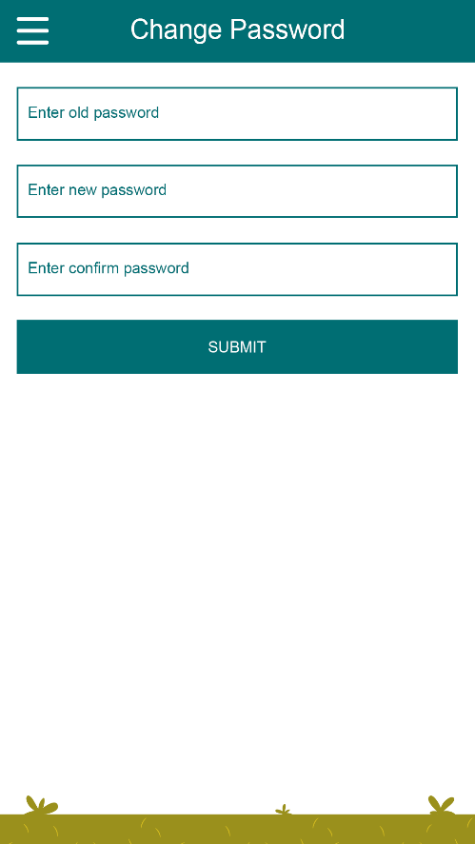
Teacher can view today’s schedule and can plan accordingly.
Change Password

Slide 6
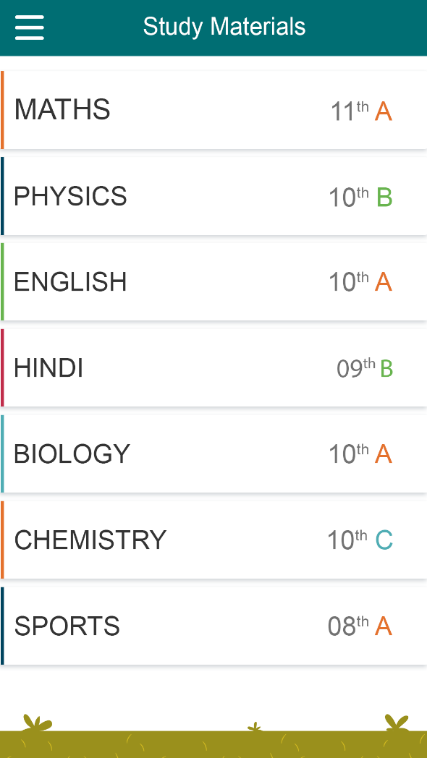
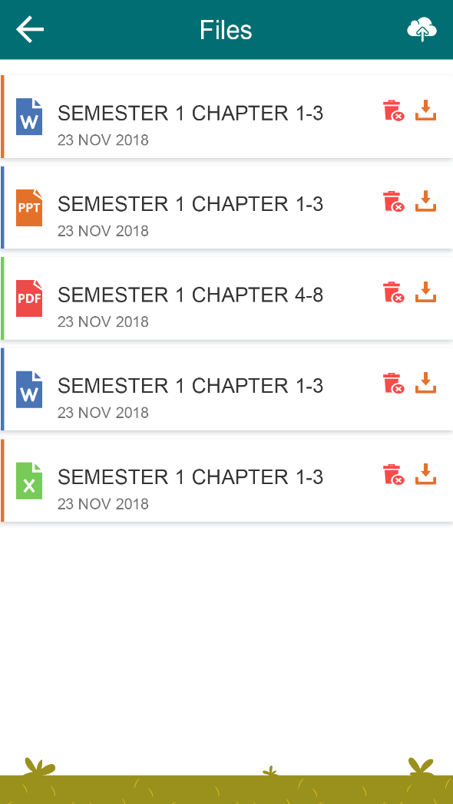
Teacher can manage(upload , edit and delete) study material for the subjects he/she teaches

Slide 7
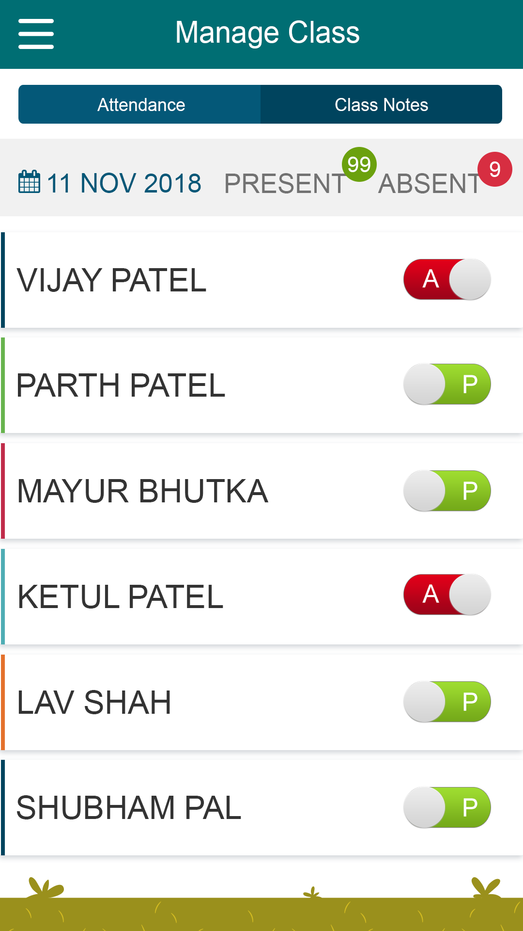
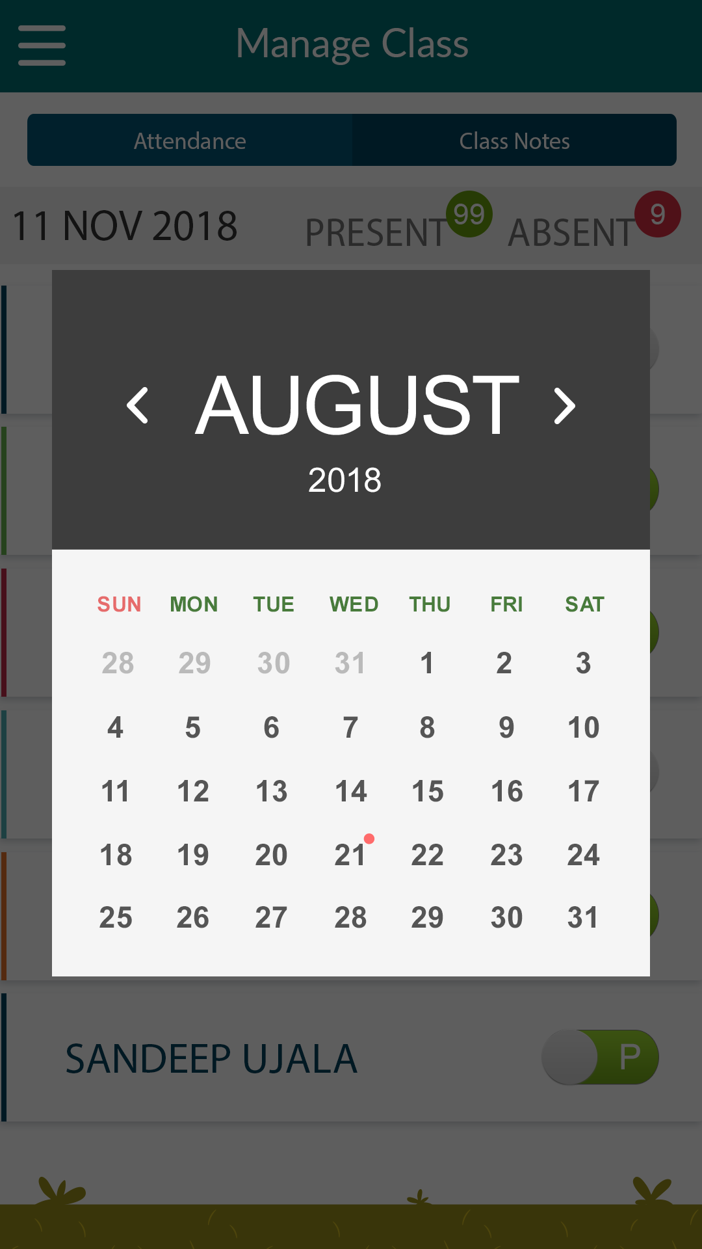
Teacher can manage class attendance (take attendance and view previous days attendance)

Slide 8
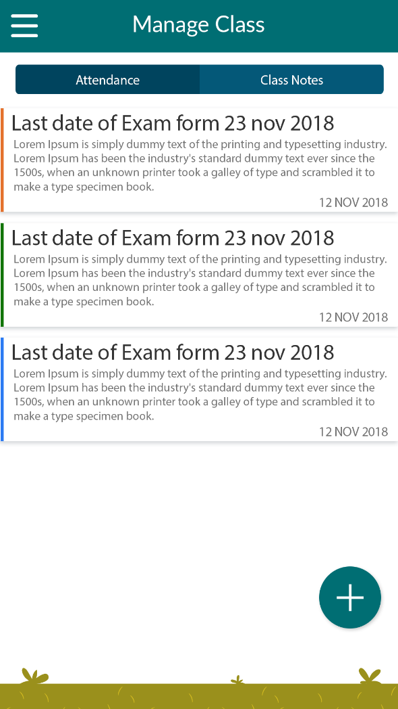
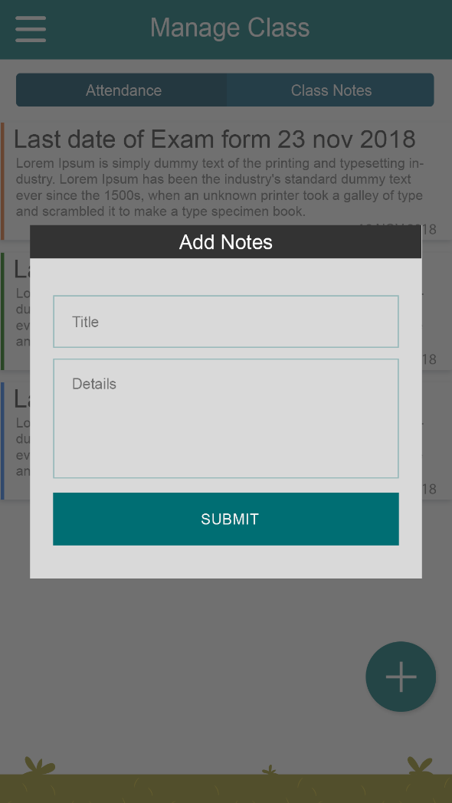
Teacher can manage class notes

Slide 9
Parent’s/Children’s Functionality
View Student Attendance / Class Notes
View Time Table
View School News / Posts via Community
Send Message(suggestions, complains, etc.) to school (Only available for parent role)
View/Download Study Material

Slide 10
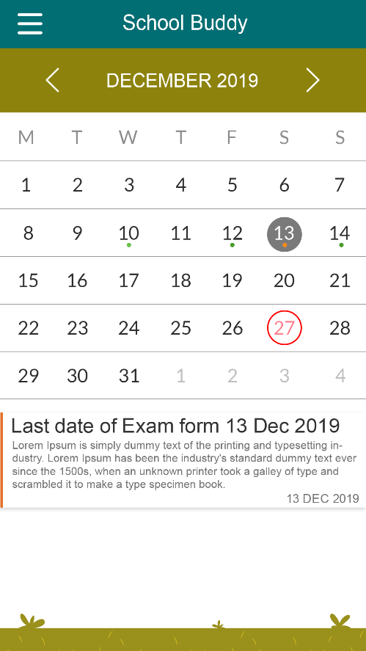
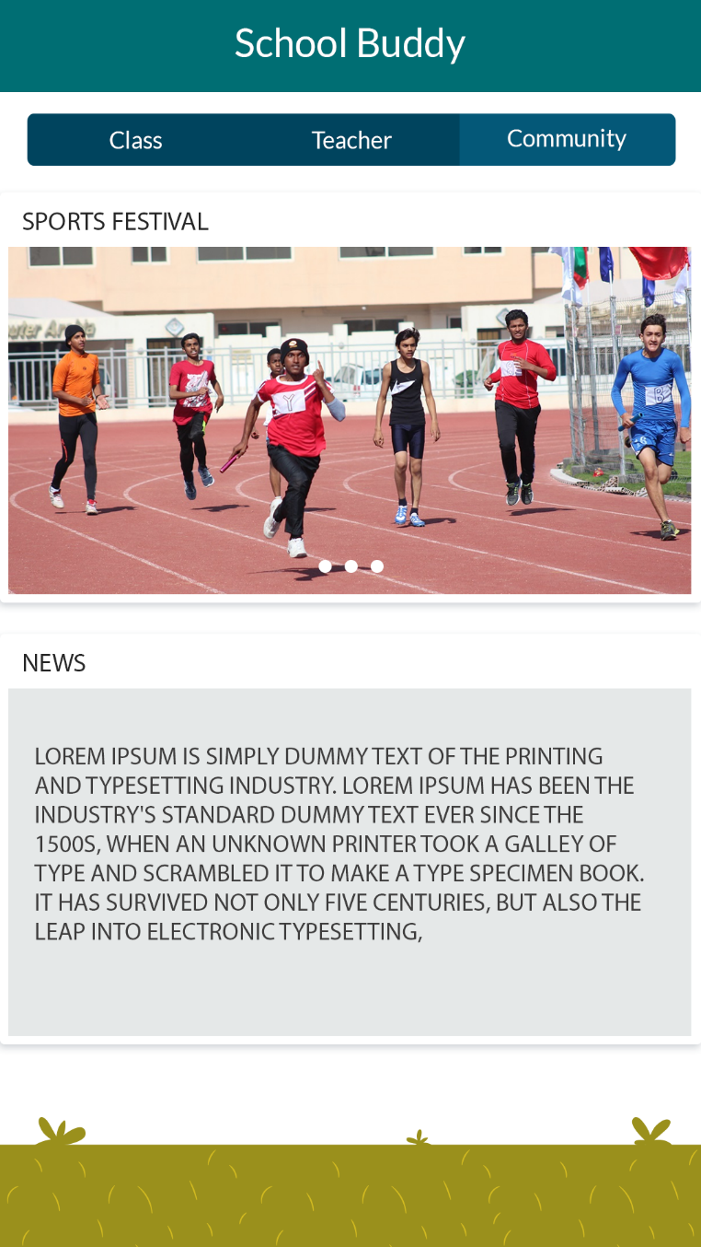
View school news / Broadcast.
View Attendance and Class notes for each day. User can click on the date to view notes for particular day.

Slide 11
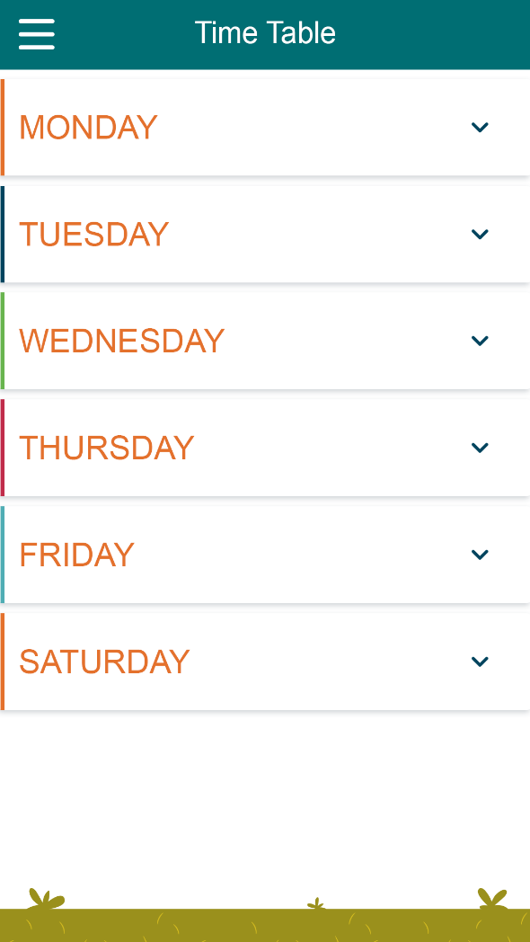
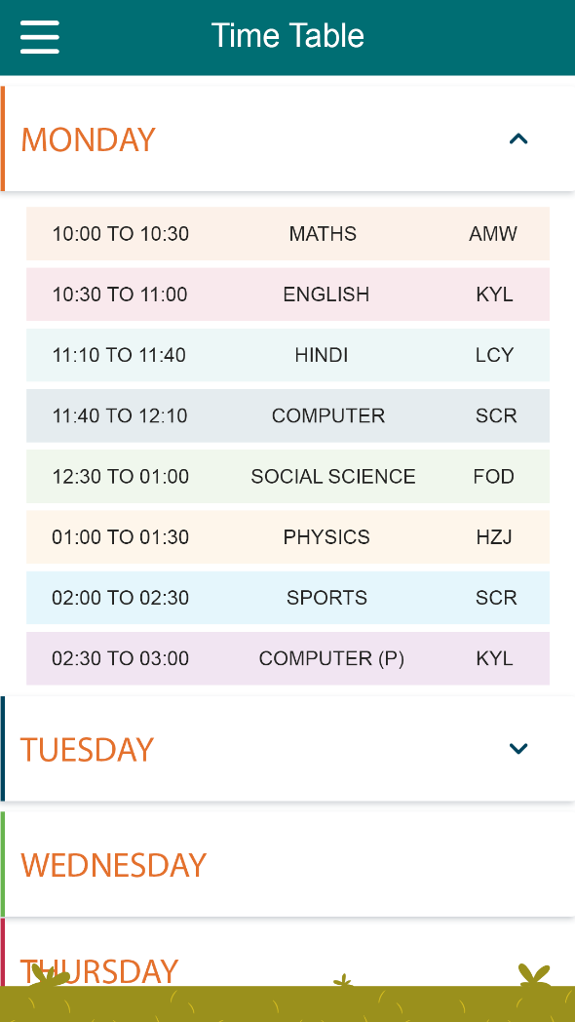
View Time table for each day

Slide 12
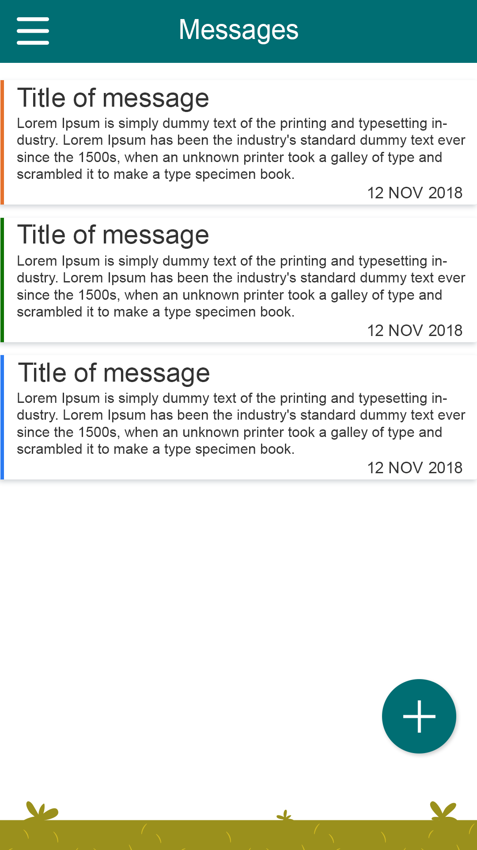
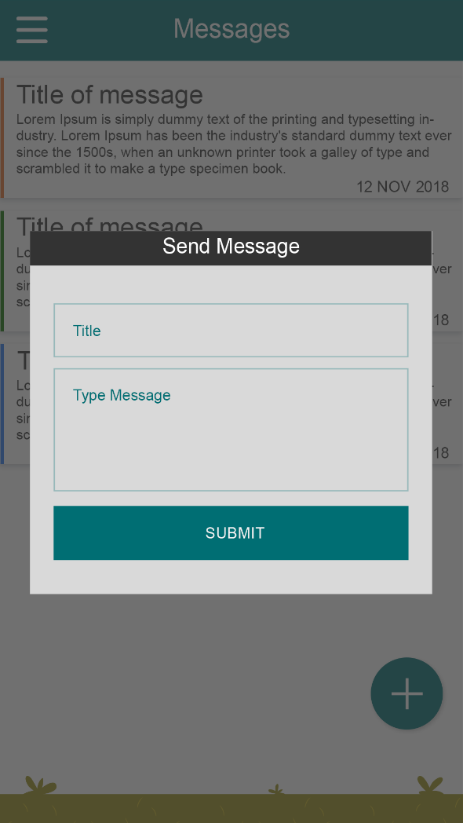
Send Message(suggestions, complains, etc.) to school (Only available for parent role)

Slide 13
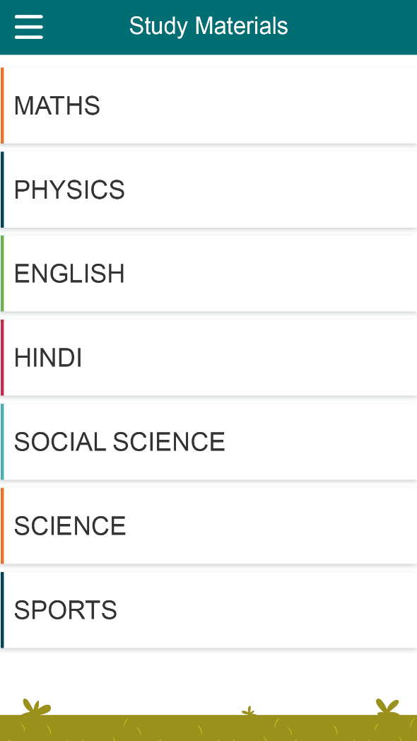
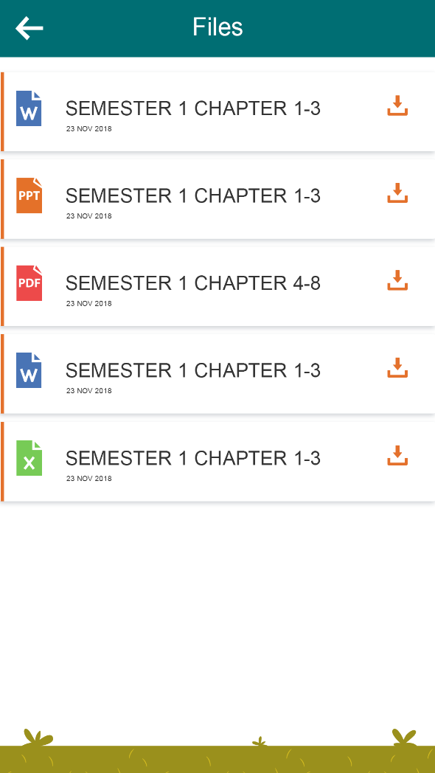
View and Download Study Material

Slide 14
Admin’s Functionality
Manage Classes
Manage Student Information
Manage Class Time Table
Manage / Broadcast School News via Community Module
Manage Support Desk for Parents

Slide 15
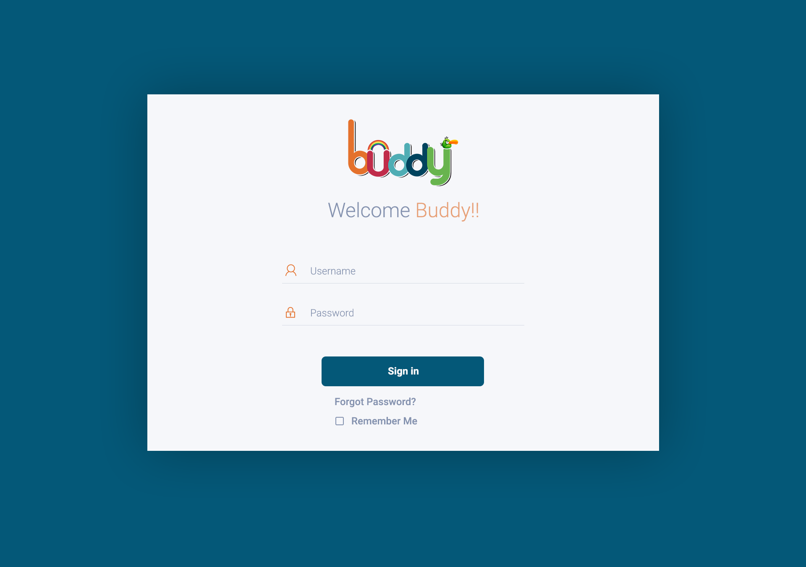

Slide 16
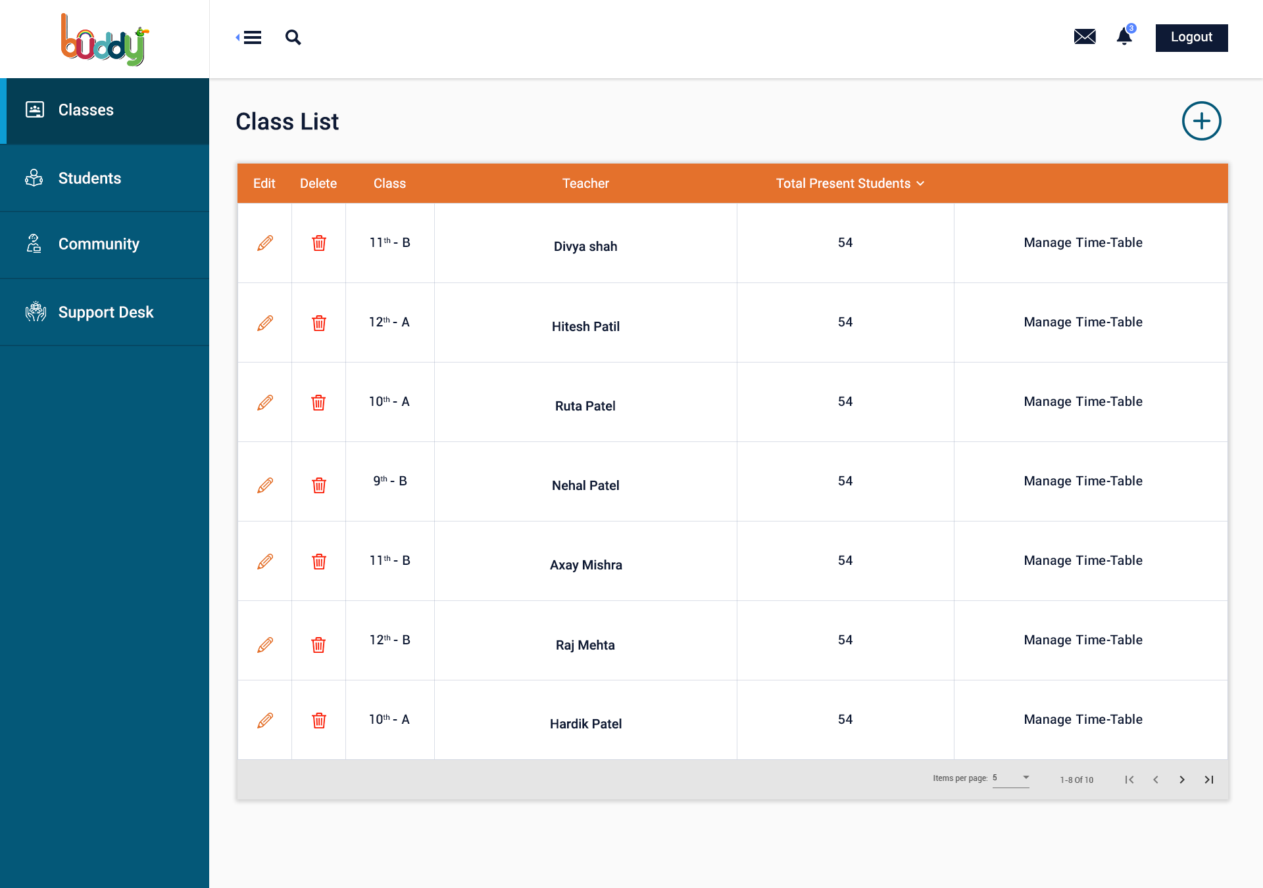
Manage Classes : Allows Admin to view/edit and delete the classes information along with the option to manage class timetable as well

Slide 17
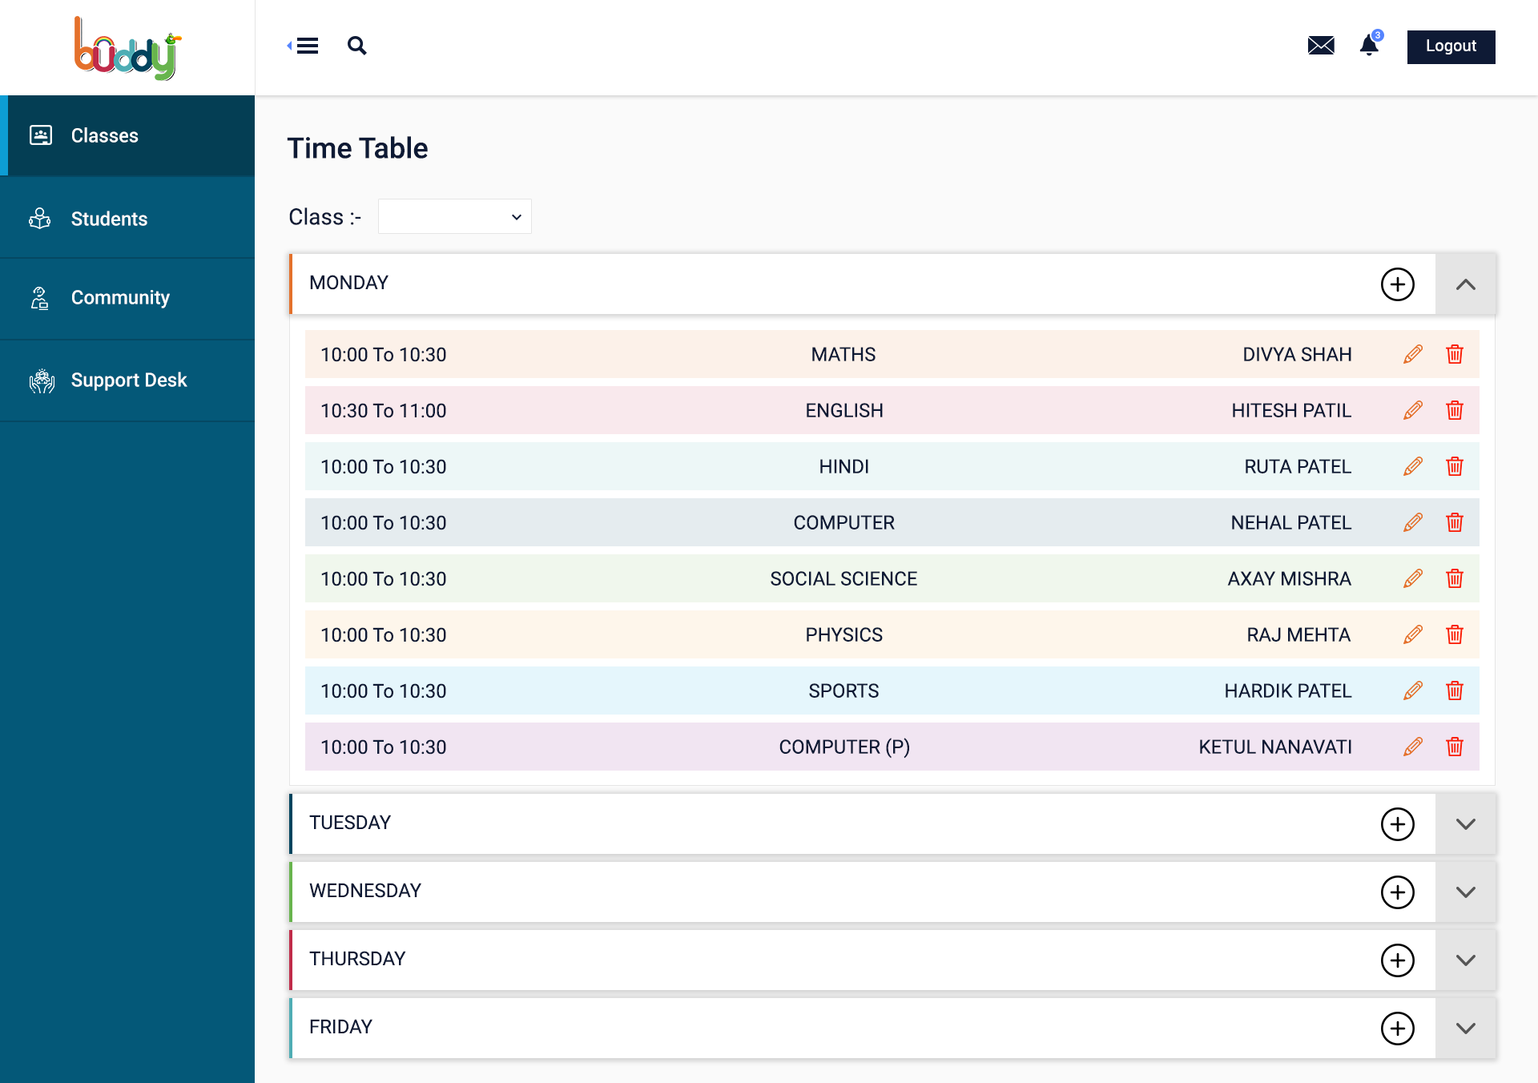
Manage Classes : Allows Admin to view/edit and delete the classes timetable

Slide 18
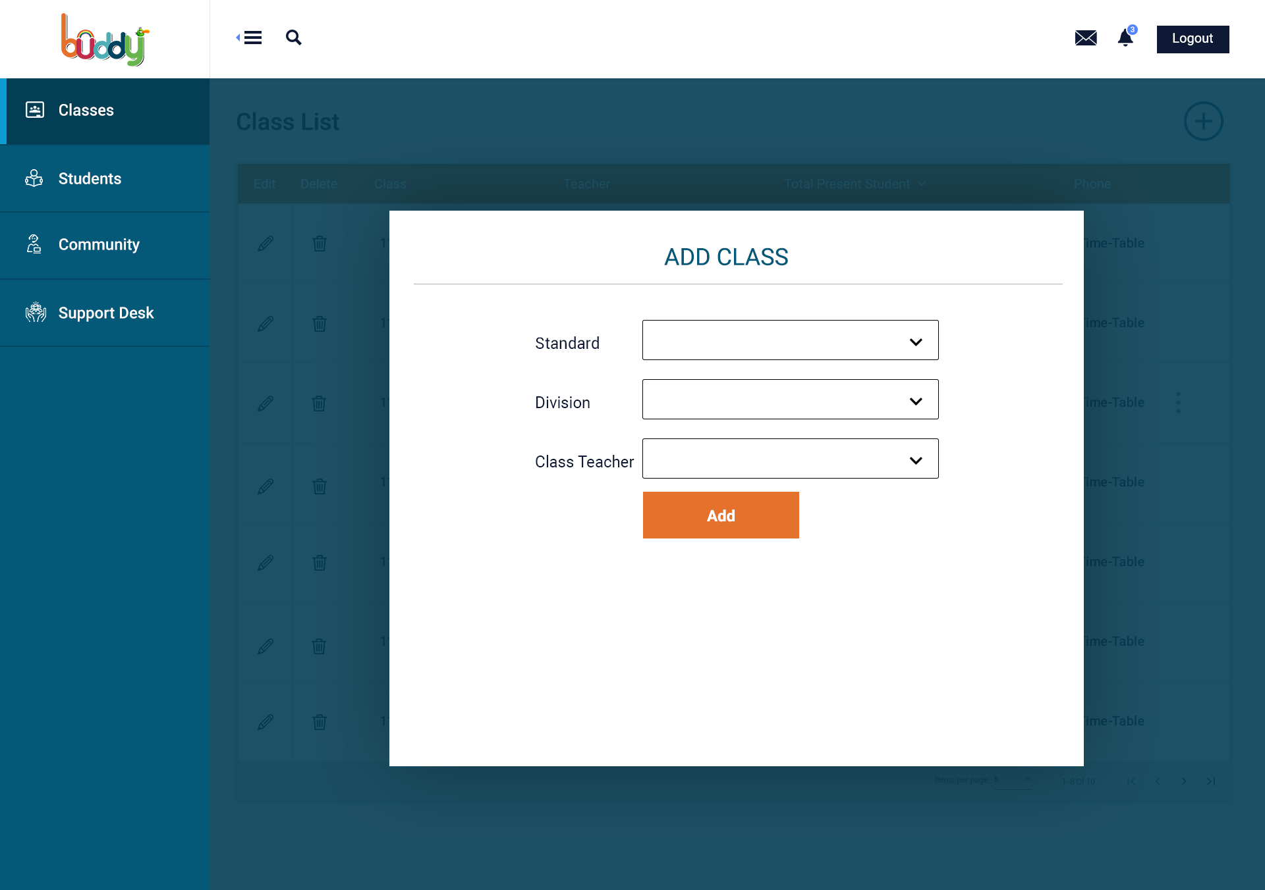
Manage Classes : Allows Admin to add new class to the system.

Slide 19
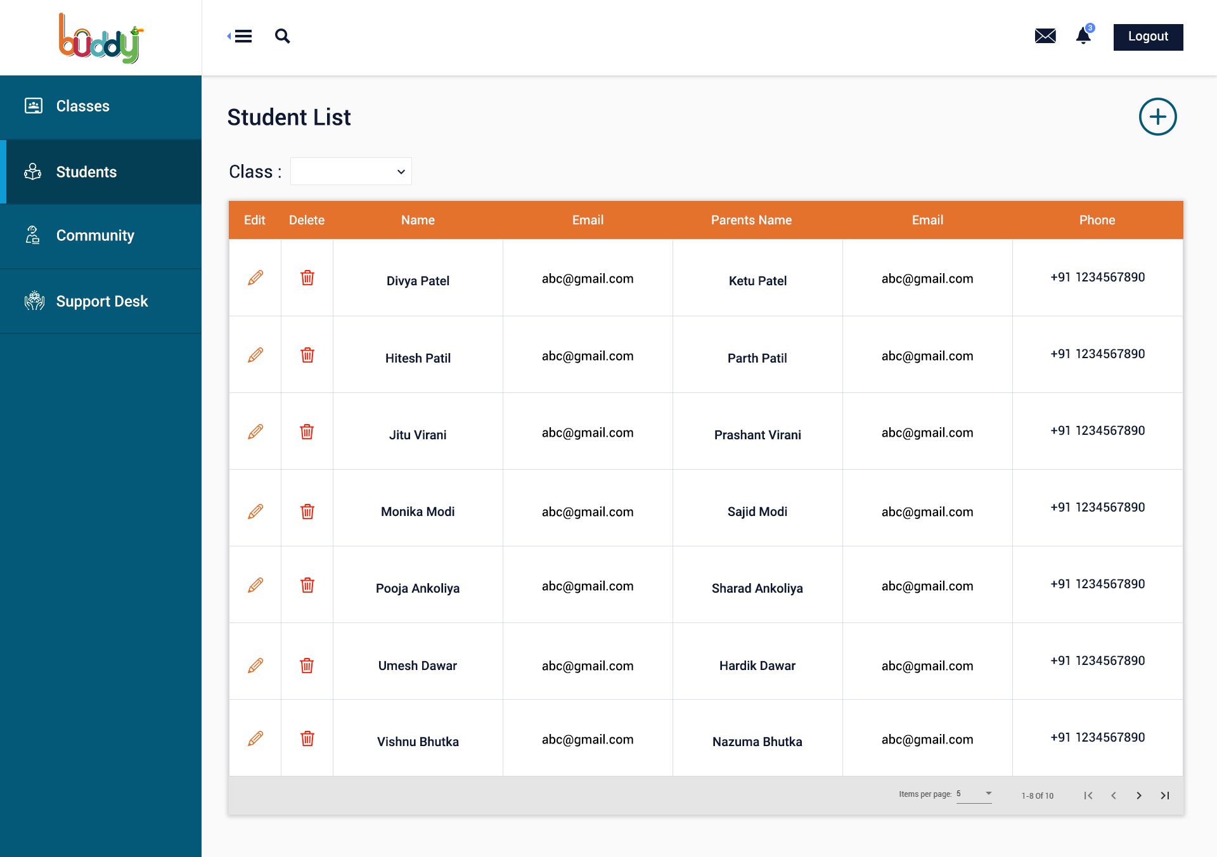
Manage Students : Allows Admin to view/edit and delete the students information

Slide 20
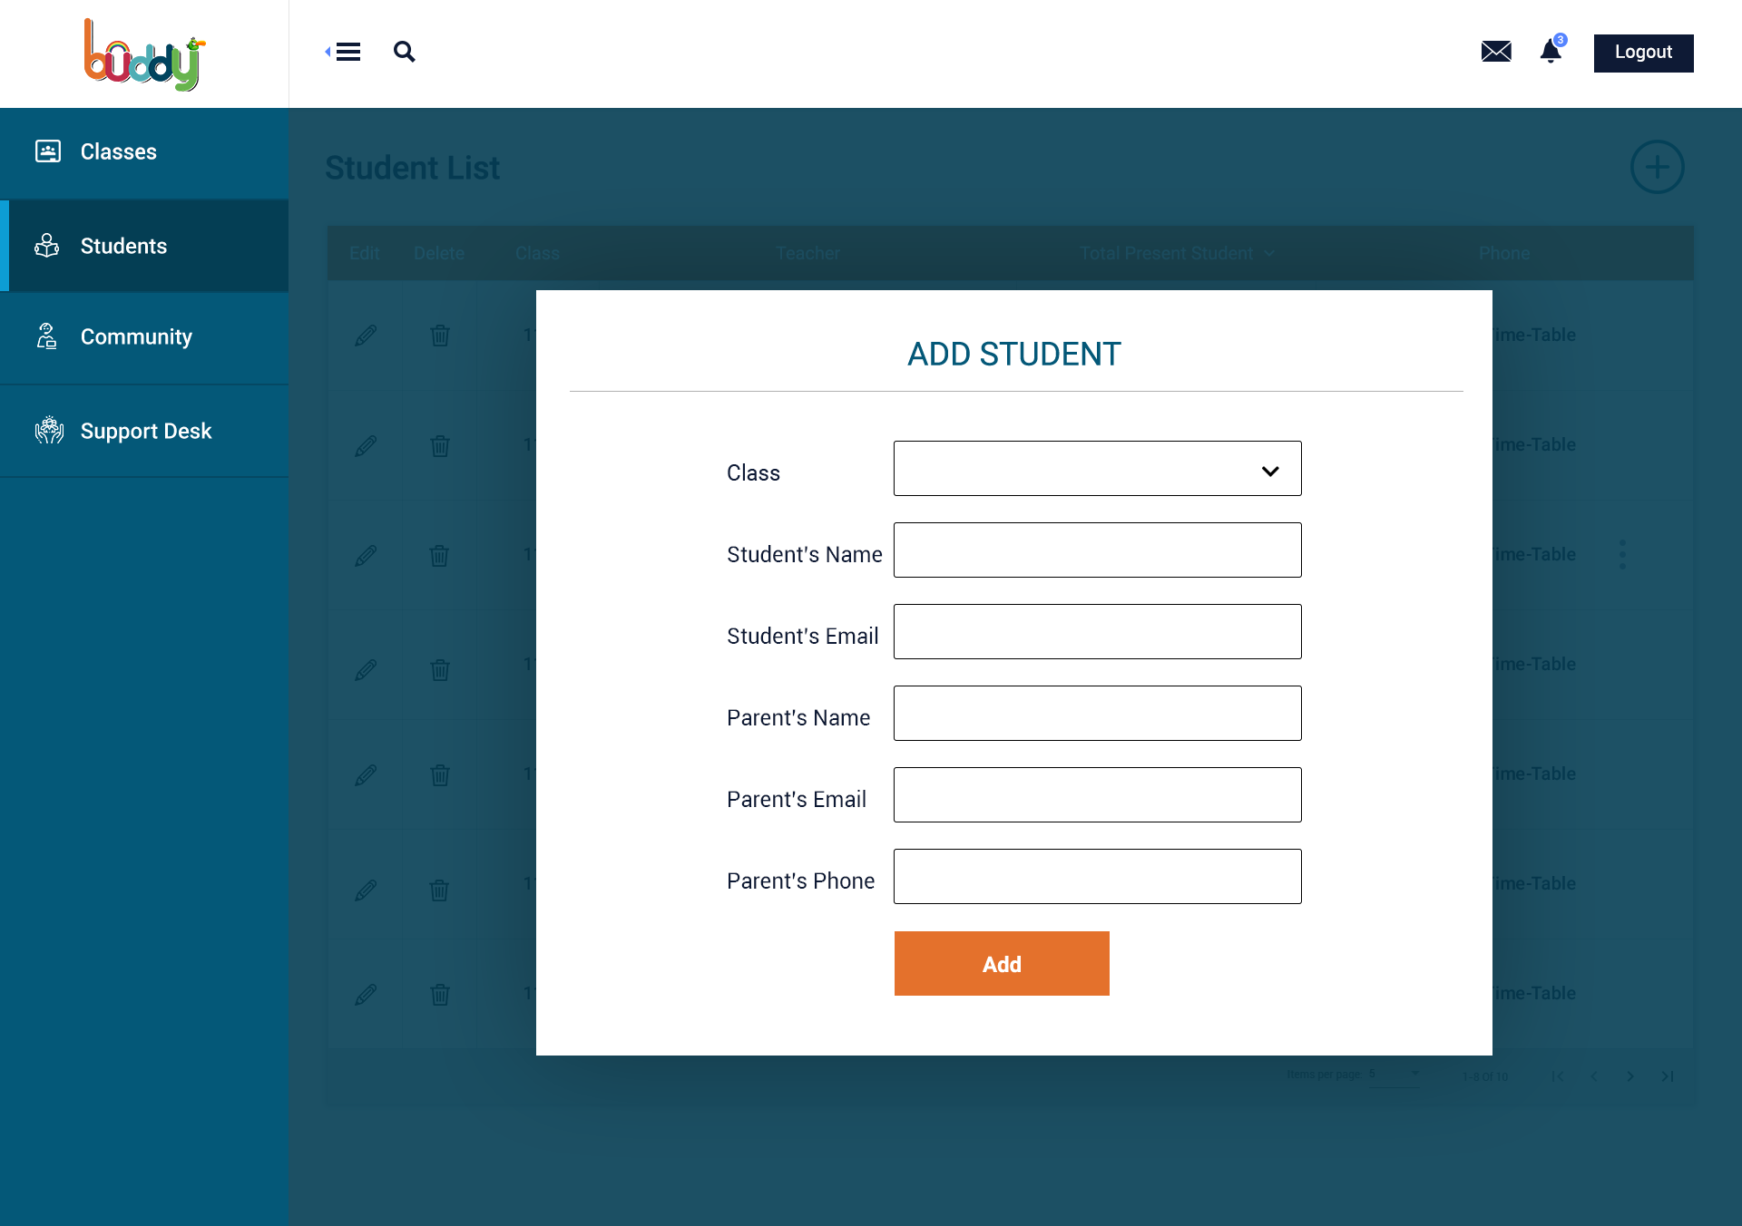
Manage Students : Allows Admin to add new student

Slide 21
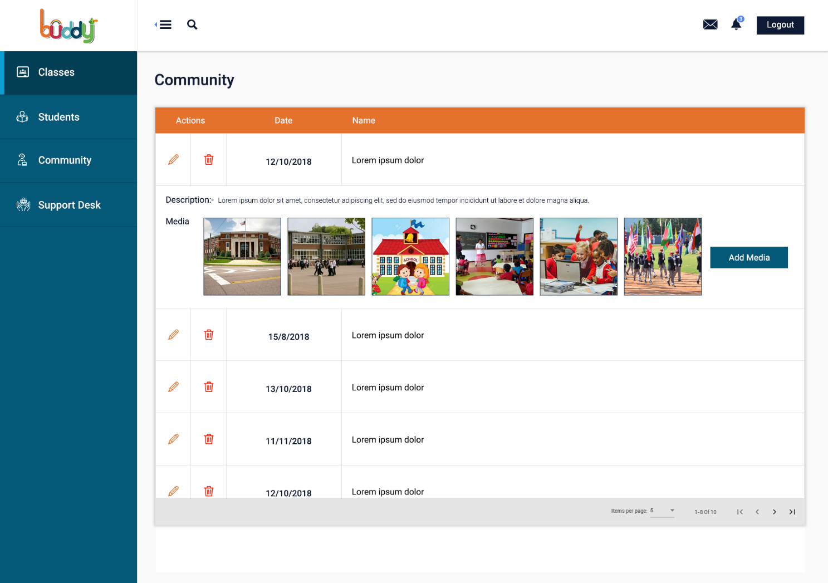
Community : Allows Admin to view/edit and delete the school news

Slide 22
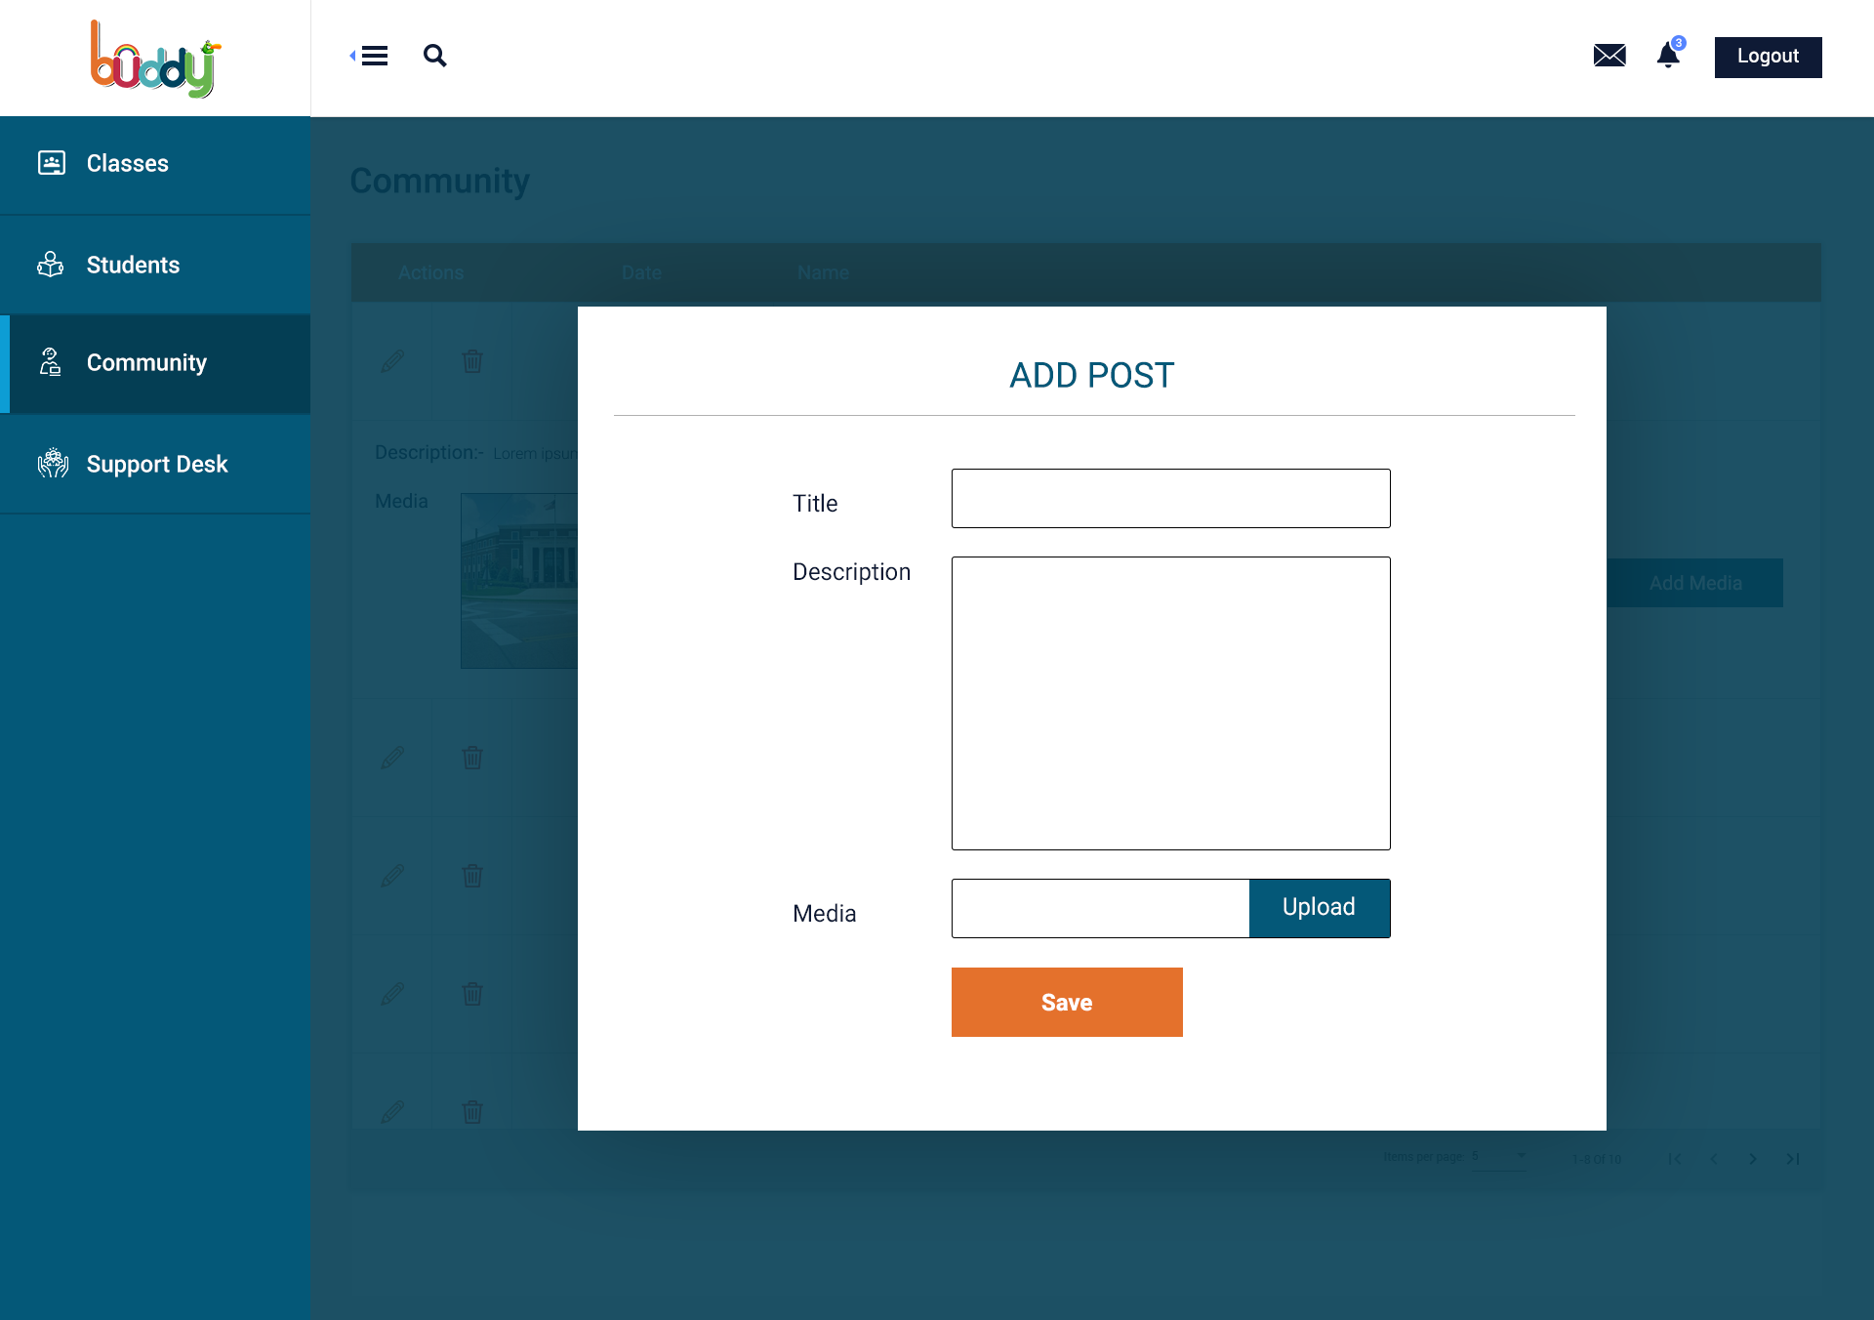
Community : Allows Admin add new news/post

Slide 23
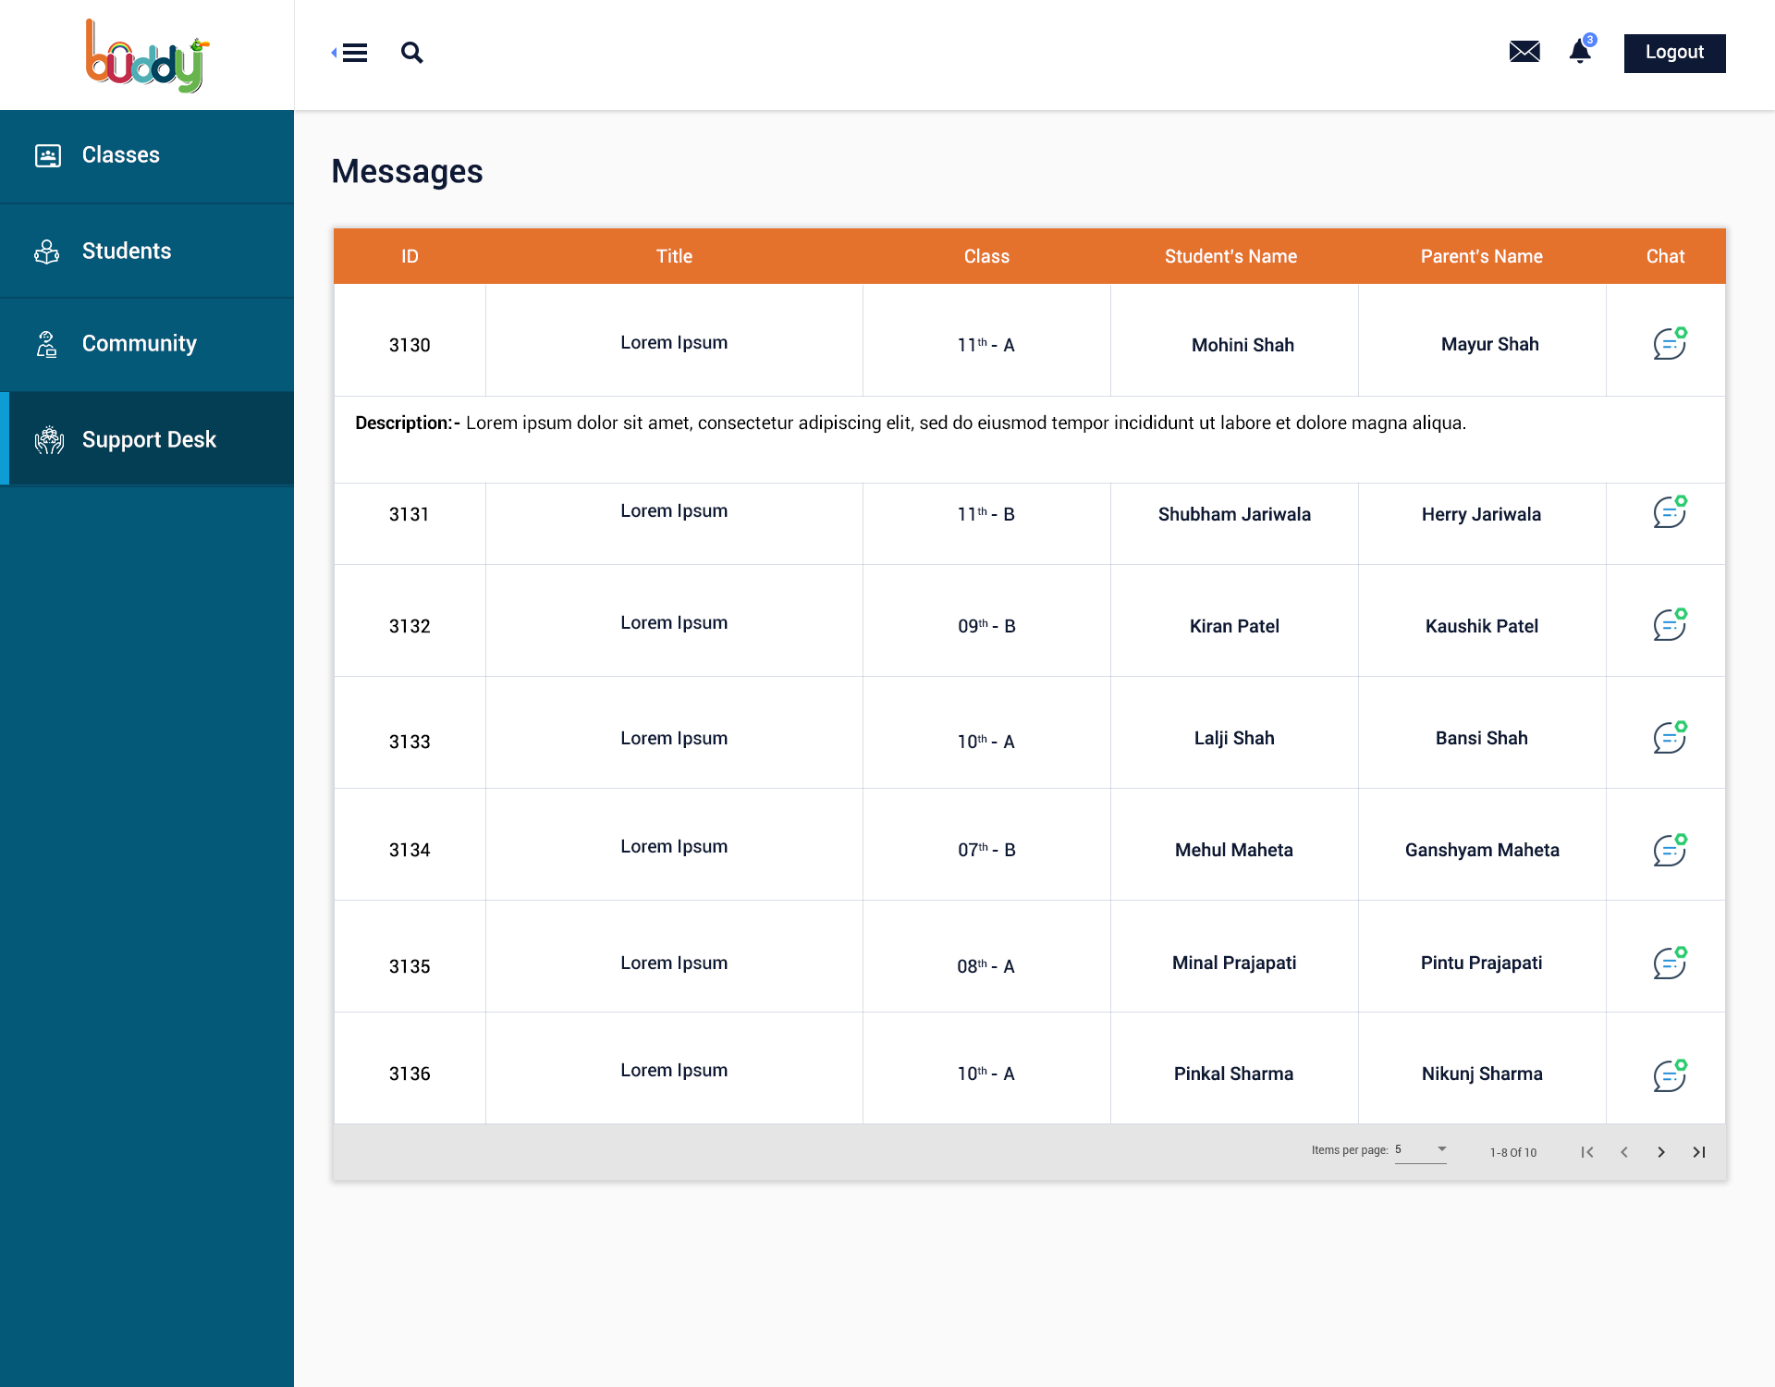
Support Desk : Allows Admin to manage support request from parents

